Slide 1

Zhanghan Ke, Yuhao Liu, Lei Zhu, Nanxuan Zhao, Rynson W.H. Lau
Neural Preset for Color Style Transfer
(CVPR 2023)
Paper Authors:
Umut Özyurt
Presentation author:
This presentation was prepared for the CENG796 - Deep Generative Models course for the Spring 2024 term.
It is part of the coursework assigned by our lecturer, Assoc. Prof. Ramazan Gokberk Cinbis.

Slide 2
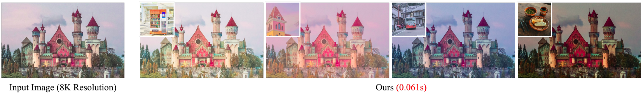

Output examples from the presented paper
Figures (from the presented paper):
https://openaccess.thecvf.com/content/CVPR2023/papers/Ke_Neural_Preset_for_Color_Style_Transfer_CVPR_2023_paper.pdf

Slide 3
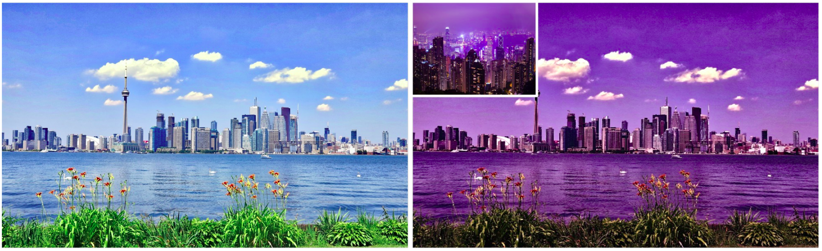
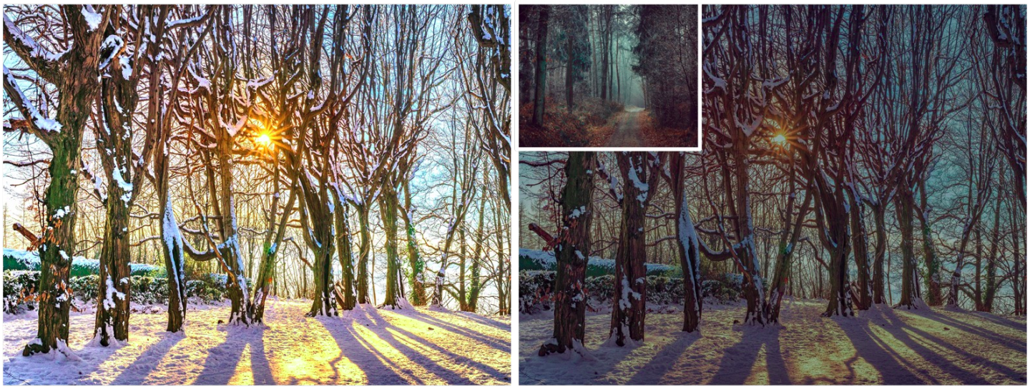
Output examples from the presented paper
Figures (from the presented papers supplemental materials):
https://openaccess.thecvf.com/content/CVPR2023/supplemental/Ke_Neural_Preset_for_CVPR_2023_supplemental.pdf

Slide 4
Overview of the presentation
Introduction
Related work
Method
Experiments
Main Contribution and Pros/Cons
Conclusion
Q & A

Slide 5
1-
Introduction

Slide 6
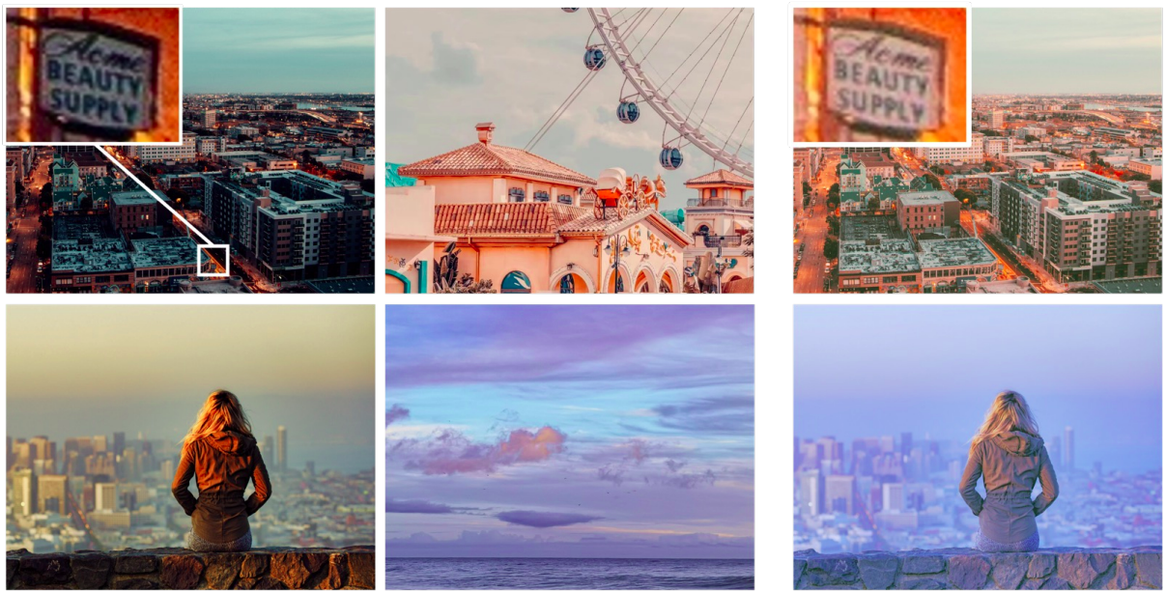
Problem Definition
Transfer only colors from an image without altering the targets texture. Hence, it is NOT artistic style transfer.
Utilize self-supervised learning.
Make the inference time fast.
Use feasible GPU memory.
Figure 1. Example color style transfers to demonstrate how well the texture remained as it should.
Figure 1 (from the presented paper):
https://openaccess.thecvf.com/content/CVPR2023/papers/Ke_Neural_Preset_for_Color_Style_Transfer_CVPR_2023_paper.pdf

Slide 7
Why Color Style Transfer?
Producing different styles of images, just like using different customizable Instagram filters.
Further utilizing the 2-stage transfer approach, switching styles are genuinely fast.
Using the models on different tasks, such as low-light image enhancement , underwater image correction , image dehazing, and image harmonization.

Slide 8
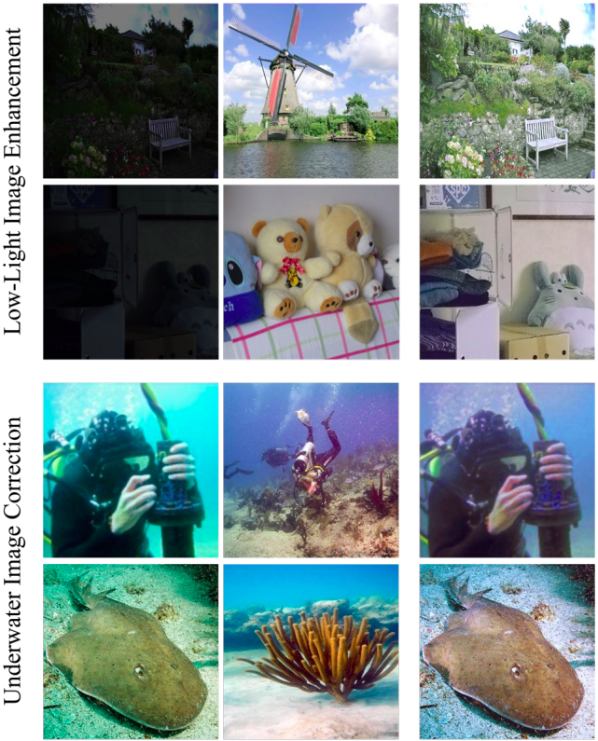
Application Examples
Figure 2. Applications of color style transfer model on Low-Light Image Enhancement and Underwater Image Correction Tasks
Figure 2 (from the presented papers supplemental materials):
https://openaccess.thecvf.com/content/CVPR2023/supplemental/Ke_Neural_Preset_for_CVPR_2023_supplemental.pdf

Slide 9
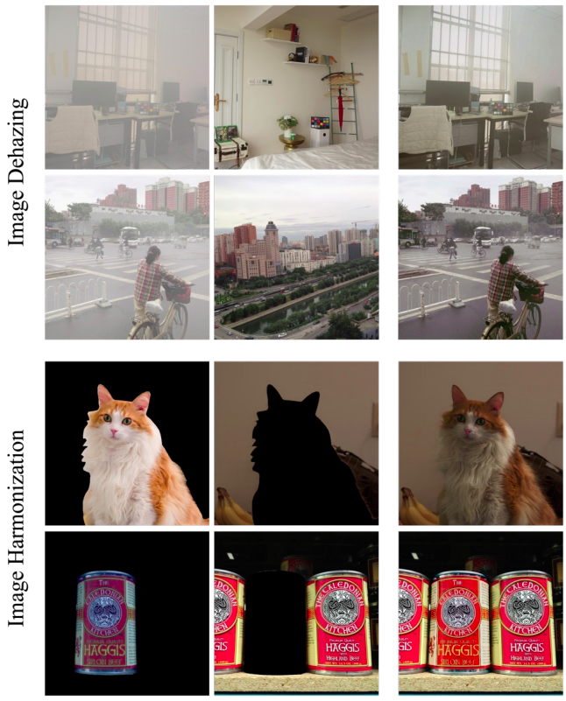
Application Examples
Figure 3. Applications of color style transfer model on Image Dehazing and Image Harmonization tasks.
Figure 3 (from the presented papers supplemental materials):
https://openaccess.thecvf.com/content/CVPR2023/supplemental/Ke_Neural_Preset_for_CVPR_2023_supplemental.pdf

Slide 10
2–
Related Work

Slide 11
Related Work
Color Style Transfer
Deterministic Color Mapping with CNNs.
Self-Supervised Learning (SSL).

Slide 12
Related Work Discussion
What is missing or should be improved so far?
Visual artifacts
High memory requirements, high inference times.
Inefficient style switch for images and low scalability for high resolution.

Slide 13
3-
Method

Slide 14
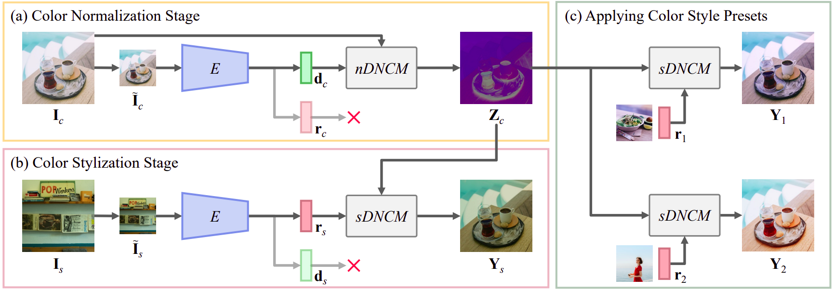
Two-Stage Pipeline
Figure 4. Proposed two-stage pipeline from the paper

Slide 15
Two-Stage Pipeline
Figure 4. Proposed two-stage pipeline from the paper

Slide 16
Two-Stage Pipeline
Figure 4. Proposed two-stage pipeline from the paper

Slide 17
Two-Stage Pipeline
Figure 4. Proposed two-stage pipeline from the paper

Slide 18
Two-Stage Pipeline
Figure 4. Proposed two-stage pipeline from the paper
Figure 4 (from the presented paper):
https://openaccess.thecvf.com/content/CVPR2023/papers/Ke_Neural_Preset_for_Color_Style_Transfer_CVPR_2023_paper.pdf

Slide 19
DNCM Mapping
What is DNCM?
Deterministic Neural Color Mapping (DNCM) is proposed in the paper to model arbitrary deterministic color mappings
It simply uses 3 matrix multiplications.

Slide 20
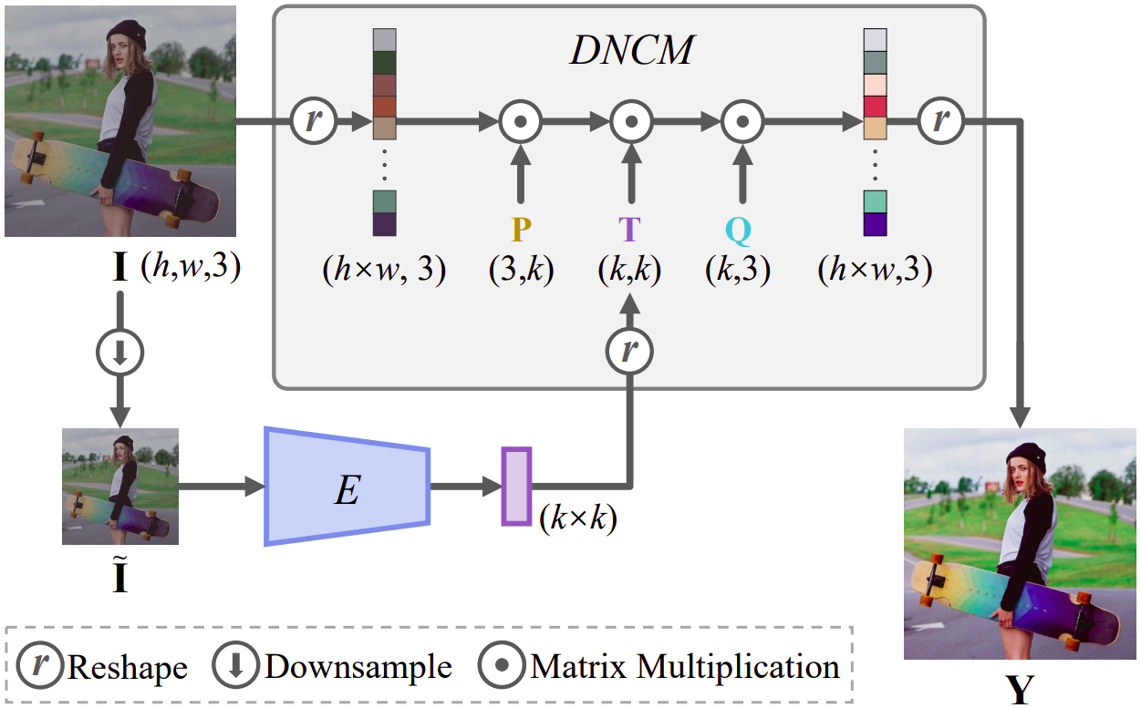
DNCM Mapping Visualization
Figure 5. Proposed DNCM Module
Figure 5 (from the presented paper):
https://openaccess.thecvf.com/content/CVPR2023/papers/Ke_Neural_Preset_for_Color_Style_Transfer_CVPR_2023_paper.pdf

Slide 21
Full Architecture
Figure 4. Proposed two-stage pipeline from the paper
Figure 5. Proposed DNCM Module
Figure 4, 5 (from the presented paper):
https://openaccess.thecvf.com/content/CVPR2023/papers/Ke_Neural_Preset_for_Color_Style_Transfer_CVPR_2023_paper.pdf

Slide 22
Full Architecture
Reusable outputs!
Combining any Z_{c} with any r_{s} is possible!
Figure 4. Proposed two-stage pipeline from the paper
Figure 4, 5 (from the presented paper):
https://openaccess.thecvf.com/content/CVPR2023/papers/Ke_Neural_Preset_for_Color_Style_Transfer_CVPR_2023_paper.pdf

Slide 23
How to Train the Models?
What parameters do we have to train?
Figure 4. Proposed two-stage pipeline from the paper
Figure 5. Proposed DNCM Module
Figure 4, 5 (from the presented paper):
https://openaccess.thecvf.com/content/CVPR2023/papers/Ke_Neural_Preset_for_Color_Style_Transfer_CVPR_2023_paper.pdf

Slide 24
How to Train the Models?
What parameters do we have to train?
A unified encoder that gets a resized (256x256) image and outputs d_{x} and r_{x} to be used in the DNCM modules.
Two P (3xk) and two Q (kx3) matrices for sDNCM and nDNCM.

Slide 25
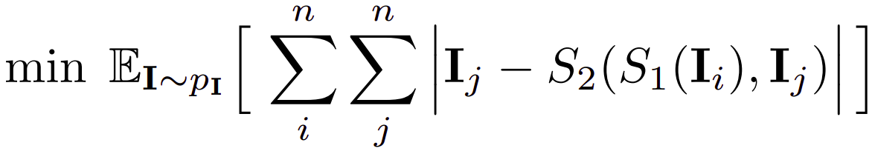
Training Objective
I_{c} is the content image, I_{s} is the style image.
S₁ is the the color normalization, and S₂ is the stylization.
I_{i} is the content image, I_{j} is the style image.
I_{i} and I_{j} are obtained from the same image with random filters.
Hence, their "content" should be same.
S₁ is the the color normalization, and S₂ is the stylization.
Equations (from the presented papers supplemental materials):
https://openaccess.thecvf.com/content/CVPR2023/supplemental/Ke_Neural_Preset_for_CVPR_2023_supplemental.pdf

Slide 26
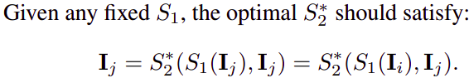
Training Objective
WARNING!
Using end-to-end CNNs (like most of the autoencoders) for S₁ and S₂ leads to a serious problem for this objective function.
S₂ can easily learn to output the identity of its right-side input, ignoring the output of S₁, perfectly optimizing the objective with a trivial solution.
So, S₂(X, I_{j}) = I_{j} can be obtained with CNNs, which is not we want.
Equations (from the presented papers supplemental materials):
https://openaccess.thecvf.com/content/CVPR2023/supplemental/Ke_Neural_Preset_for_CVPR_2023_supplemental.pdf

Slide 27
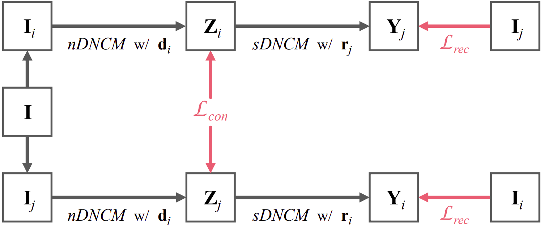
Self-Supervised Learning
Figure 6. Self-Supervised Learning approach.
Figure 6 (from the presented paper):
https://openaccess.thecvf.com/content/CVPR2023/papers/Ke_Neural_Preset_for_Color_Style_Transfer_CVPR_2023_paper.pdf

Slide 28
Self-Supervised Learning
Obtain I_{i} and I_{j} from the same I by applying perturbations (random image filters).
Get the d_{i}/r_{i} and d_{j}/r_{j} from the encoder outputs. Apply d_{i} and d_{j} to I_{i} and I_{j} , respectively, with nDNCM to get normalized color space outputs Z_{i} and Z_{j}.
Apply r_{i} and r_{j} to Z_{j} and Z_{i}, respectively, to get stylized images.
Figure 6. Self-Supervised Learning approach.
Figure 6 (from the presented paper):
https://openaccess.thecvf.com/content/CVPR2023/papers/Ke_Neural_Preset_for_Color_Style_Transfer_CVPR_2023_paper.pdf

Slide 29
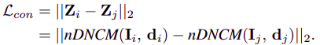
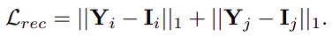
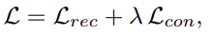
Training Objectives
We want Z_{i} and Z_{j} to be exactly the same.
We want Y_{i} and I_{j} to be exactly the same.
We want Y_{j} and I_{i} to be exactly the same
Figure 6. Self-Supervised Learning approach.
Figure 6 (from the presented paper):
https://openaccess.thecvf.com/content/CVPR2023/papers/Ke_Neural_Preset_for_Color_Style_Transfer_CVPR_2023_paper.pdf

Slide 30
4-
Experiments

Slide 31
Datasets and Implementation
MS COCO dataset (*) for training.
5000 LUTs, and input color perturbations (**) for getting I_{i} and I_{j}.
EfficientNet-B0 is used with 256x256 input size as the encoder.
K is picked as 16.
Trained with Adam for 32 epochs.
* Microsoft COCO: Common Objects in Context
https://arxiv.org/pdf/1405.0312
** Harmonizer: Learning to Perform White-Box Image and Video Harmonization
https://arxiv.org/pdf/2207.01322
*** EfficientNet: Rethinking Model Scaling for Convolutional Neural Networks
https://arxiv.org/pdf/1905.11946

Slide 32
Quantitive Evaluation
They observed prior metrics does not measure quality well.
For style similarity, they trained a discriminator on a labeled dataset (with 700+ style classes) to predict the style similarity.
For content similarity, they compute SSIM on image edges. Prior works used HED (*), but since it is often incorrect and predict only rough edges, they replaced it with LDC (**).
* Holistically-Nested Edge Detection
https://openaccess.thecvf.com/content_iccv_2015/papers/Xie_Holistically-Nested_Edge_Detection_ICCV_2015_paper.pdf
** LDC: Lightweight Dense CNN for Edge Detection
https://www.researchgate.net/publication/361823660_LDC_Lightweight_Dense_CNN_for_Edge_Detection

Slide 33
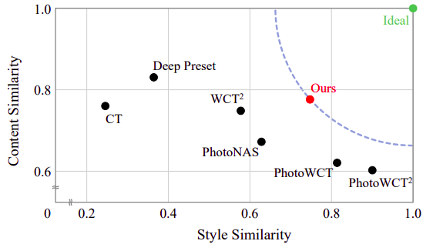
Similarity Comparison
Figure 7. Similarity comparisons with prior methods
Figure 7 (from the presented paper):
https://openaccess.thecvf.com/content/CVPR2023/papers/Ke_Neural_Preset_for_Color_Style_Transfer_CVPR_2023_paper.pdf

Slide 34
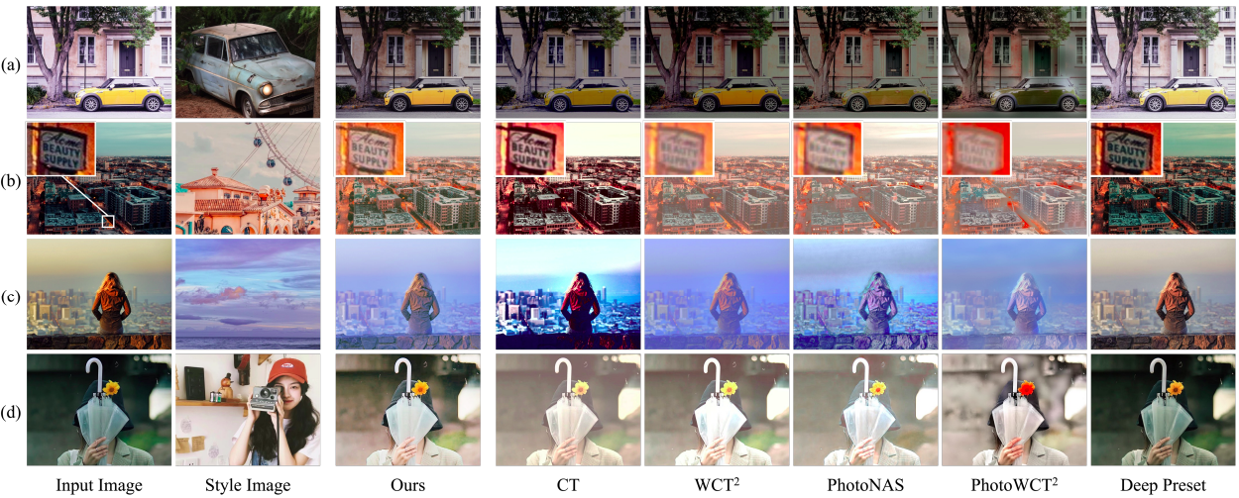
Similarity Comparison
Figure 8. Average Human Ranking (subjective) Comparisons
Figure 9. Qualitative Comparisons
Figure 8, 9 (from the presented paper):
https://openaccess.thecvf.com/content/CVPR2023/papers/Ke_Neural_Preset_for_Color_Style_Transfer_CVPR_2023_paper.pdf

Slide 35
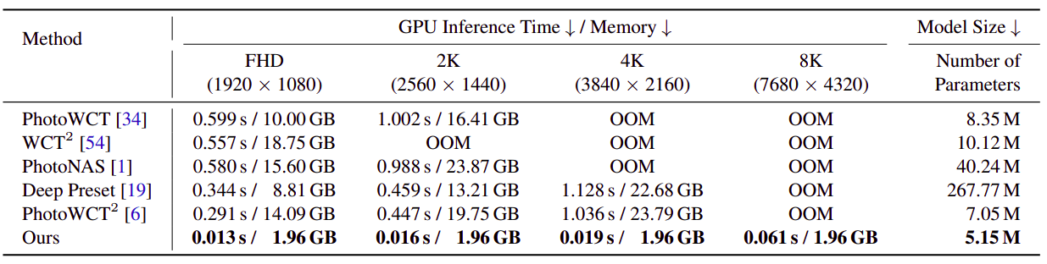
Inference Time Comparison
Figure 10. Inference Time, GPU memory and Model Size comparisons with RTX3090 GPU.
Figure 10 (from the presented paper):
https://openaccess.thecvf.com/content/CVPR2023/papers/Ke_Neural_Preset_for_Color_Style_Transfer_CVPR_2023_paper.pdf

Slide 36
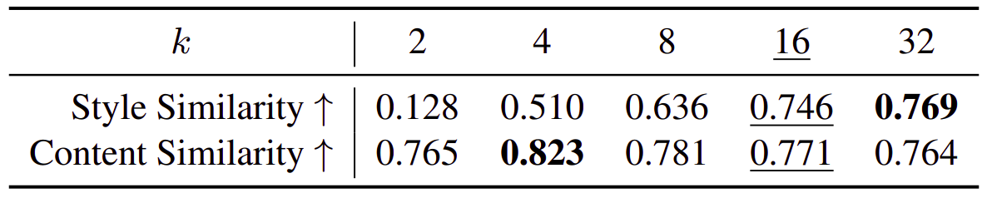
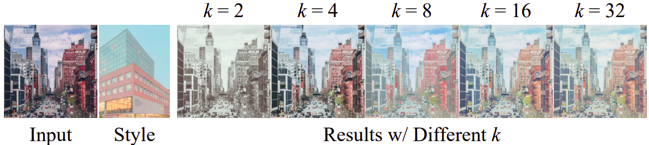
Ablation Studies
Figure 11. Effect of the "k" hyper-parameter on the similarity values.
Figure 12. Effect of the "k" hyper-parameter visualized.
Figure 11, 12 (from the presented paper):
https://openaccess.thecvf.com/content/CVPR2023/papers/Ke_Neural_Preset_for_Color_Style_Transfer_CVPR_2023_paper.pdf

Slide 37
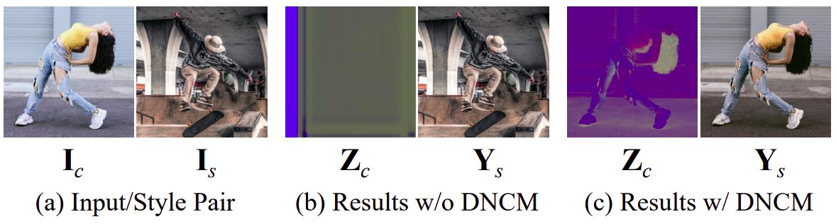
Ablation Studies
Figure 13. Effect of not using DNCM. Demonstration of the tendency to escaping to a trivial solution.
Figure 13 (from the presented paper):
https://openaccess.thecvf.com/content/CVPR2023/papers/Ke_Neural_Preset_for_Color_Style_Transfer_CVPR_2023_paper.pdf

Slide 38
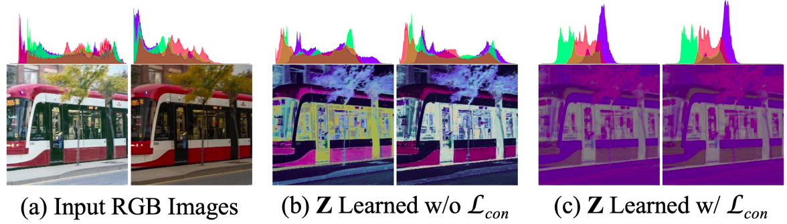
Ablation Studies
Figure 14. Effect of not using consistency loss
Figure 14 (from the presented paper):
https://openaccess.thecvf.com/content/CVPR2023/papers/Ke_Neural_Preset_for_Color_Style_Transfer_CVPR_2023_paper.pdf

Slide 39
5-
Main Contribution
and Pros/cons

Slide 40
Main Contribution
DNCM (Deterministic Neural Color Mapping) to avoid artifacts.
Two-stage approach, enables caching and provides high speed.
Self-supervised learning approach.
Custom/improved and better quantitative similarity metrics.

Slide 41
Advantages
The approach can scale efficiently with high resolution inputs.
DNCM and two-stage approach significantly reduced the computational expense (Low GPU memory usage and approximately 28x speed up).
Most of the major artifacts avoided with DNCM. It is crucial for keeping the delicate content such as text readability.
Without fine-tuning, the model can be used in other tasks such as low-light enhancement.

Slide 42
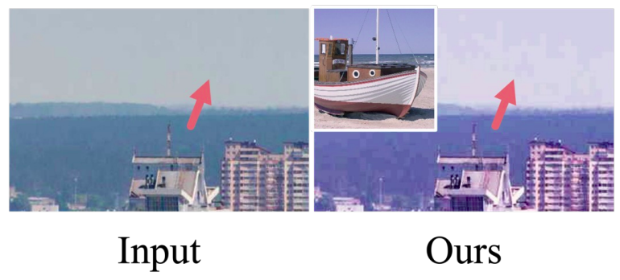
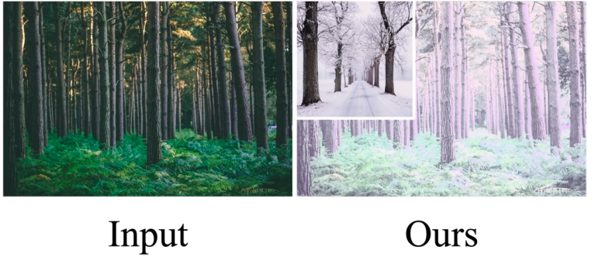
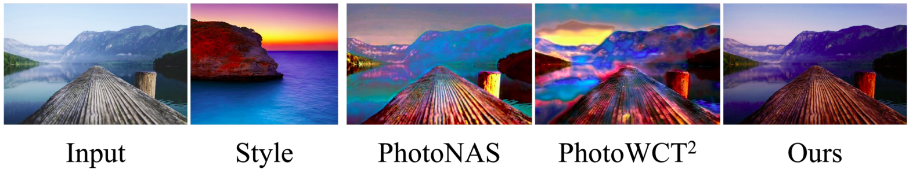
Disadvantages
The approach is observed to increase JPEG artifacts.
If some content colors does not exist on the style image, result may be unwanted.
Local-adaptive color style transfer is not supported.
Figure 15. Demonstration of increased JPEG artifacts
Figure 16. Unsatisfactory outputs
Figure 17. Demonstration of the lack of local-adaptive mapping
Figure 15, 16, 17 (from the presented paper):
https://openaccess.thecvf.com/content/CVPR2023/papers/Ke_Neural_Preset_for_Color_Style_Transfer_CVPR_2023_paper.pdf

Slide 43
6-
Conclusion

Slide 44
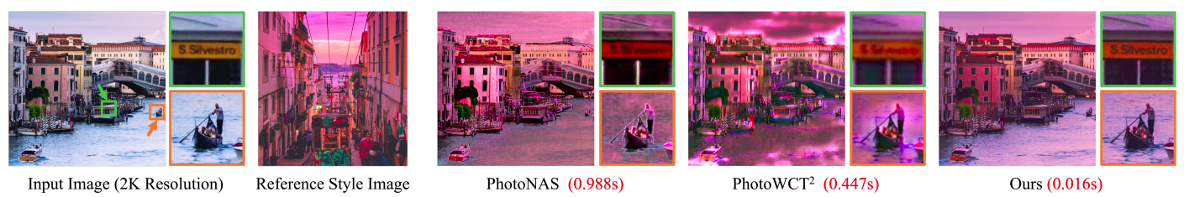
Conclusion
Using a two-stage approach may tremendously speed up the inference time when switching styles.
The self-supervised approach can be utilized with DNCM approach, which also avoids some distortions.
No need for deep and heavy architectures for color style transfer.
Figure 18. Output comparison of the proposed method including the inference times
Figure 18 (from the presented paper):
https://openaccess.thecvf.com/content/CVPR2023/papers/Ke_Neural_Preset_for_Color_Style_Transfer_CVPR_2023_paper.pdf

Slide 45
References (1 of 2)
Ke, Z., Liu, Y., Zhu, L., Zhao, N., & Lau, R. W. H. (2023, March 23). Neural Preset for Color Style Transfer. arXiv.org. https://arxiv.org/abs/2303.13511
Ke, Z., Sun, C., Zhu, L., Xu, K., & Lau, R. W. H. (2022, July 4). Harmonizer: Learning to Perform White-Box Image and Video Harmonization. arXiv.org. https://arxiv.org/abs/2207.01322
Lin, T. Y., Maire, M., Belongie, S., Bourdev, L., Girshick, R., Hays, J., Perona, P., Ramanan, D., Zitnick, C. L., & Dollár, P. (2014, May 1). Microsoft COCO: Common Objects in Context. arXiv.org. https://arxiv.org/abs/1405.0312

Slide 46
References (2 of 2)
Soria, X. G., Pomboza-Junez, G., & Sappa, N. D. (2022, January 1). LDC: Lightweight Dense CNN for Edge Detection. IEEE Access. https://doi.org/10.1109/access.2022.3186344
Tan, M., & Le, Q. (2019, May 28). EfficientNet: Rethinking Model Scaling for Convolutional Neural Networks. arXiv.org. https://arxiv.org/abs/1905.11946
Xie, S., & Tu, Z. (2015, December 1). Holistically-Nested Edge Detection. https://doi.org/10.1109/iccv.2015.164

Slide 47
Attribution
Keep this page and the following notice AS IS.
This presentation has been prepared with METU Presentation Template by Devrim Çavuşoğlu licensed under the CC BY-SA 4.0. Also read, the full LICENSE content.
Refer to github.com/devrimcavusoglu/metu-presentation-template

Slide 48
Thank you for listening
Q & A

